Slide 1

Sales Review

Slide 2
Performance Review
THIS IS A SAMPLE OF A TYPICAL SALES PERFORMANCE REVIEW OR A MONTHLY SALE REPORT
WHILE THIS REPORT IS BASED ON KEY SALES METRICS, THE METRICS THEMSELVES CAN BE CHANGED AS PER THE REQUIREMENT OF THE COMPANY AND THE COMPANY KPIs

Slide 3
Performance Review – METRICS / KPIs
KPIs are very important to analyse how the combined Sales & Marketing efforts are working, which includes Marketing, Lead Generation, Sales. Compare the monthly sales KPIs with previous month’s results to see whether your sales performance is increasing or declining. Always look for the root cause of poor results – is your sales slowing because of low season, lazy salespeople or poor marketing decisions?
Moreover, track the number of monthly new leads to get to the core of your sales performance. Many sales metrics overlap with the ones measured by the marketing department. CEO/manager dashboard is not only about KPIs but also comparative month-to-month charts and graphs. For example, a line chart of monthly new leads / sales is a great way to spot the trend and adjust your marketing and sales activities accordingly.

Slide 4
Performance Review
There are a countless number of key performance indicators that you can measure to evaluate your sales performance. But notice the word KEY.
Only measure and collect the sales KPIs that show relevant data and that you’re able to improve. Choose the data on your dashboard wisely and only include the metrics that are part of your company’s narrative. Only then can you achieve all your goals and improve your business’s profitability.
Here are some of the KPIs and Sales Metrics that can be reported on given the availability of data.
Monthly sales/new customers
Monthly new leads/prospects
Lead-to-sale conversion rate
Cost per lead
Cost per conversion
Customer lifetime value (CLV)/customer profitability (CP)

Slide 5
Performance Review
Customer turnover rate
Net promoter score
Average conversion time
Effectiveness of sales demos
Relative market share
Product/service usage
Website conversion rate
KPIs TO CHECK SALES MARKETING ALIGNMENT
End-to-end conversion ratio
Sales cycle timeline
Marketing qualified leads (MQLs) to opportunity ratio
Opportunity to customer ratio
Revenue diversity
Percentage of content used by sales
Revenue per account

Slide 6
SALES PERFORMANCE ANALYSIS
SAMPLE REPORT / CHARTS

Slide 7
Performance Review – Sample Report
$450,000

Slide 8
ABC Revenue Plan vs. Actual
FY 2020
REGION | ABC Target for FY 2011(in USD) | Actual Cumulative | % Achieved
US - Internal | $2,202,000 | $1,718,612 | 78%
US - External | $1,605,500 | $897,492 | 56%
Sales Executive 1 | $632,500 | $514,262 | 81%
Corporate Acct | $973,000 | $383,230 | 39%
EUROPE - External | $1,481,280 | $1,237,937 | 84%
Corporate Acct | $413,000 | $587,762 | 142%
Sales Executive 1 | $484,780 | $441,850 | 91%
Sales Executive 2 | $583,500 | $208,325 | 36%
APAC - External | $204,000 | $144,610 | 71%
Sales Executive 1 | $204,000 | $144,610 | 71%
TOTAL ABC | $5,492,780 | $3,998,651 | 73%

Slide 9
ABC Revenue through various streams
Revenue sources | ABC Target for FY 2020 (in USD) | Actual Cumulative | % Achieved
Internal | $2,202,000 | $1,718,612 | 78%
Existing | $1,699,780 | $1,236,939 | 73%
External APAC | $104,000 | $122,258 | 118%
External Europe | $897,780 | $735,503 | 82%
External US | $698,000 | $379,178 | 54%
VAR/Partner | $328,500 | $14,448 | 4%
Contract Engineering | $240,000 | $0 | 0%
New Customers | $1,022,500 | $1,028,653 | 101%
External APAC | $50,000 | $22,352 | 45%
External Europe | $460,000 | $488,780 | 109%
External US | $512,500 | $505,509 | 99%
Total ABC | $5,492,780 | $3,998,652 | 73%

Slide 10
COMPANY ABC

Slide 11
ABC

Slide 12
ABC Revenues (Region Wise)

Slide 13
ABC External Revenue

Slide 14
Revenue – ABC Top 3 Customers Vs. Others (QoQ)

Slide 15
New Customers Added - Region

Slide 16
Region 1 Revenue Trend

Slide 17
Region 1 Revenue (QoQ)

Slide 18
Region 1 Revenue - Top 3 Customers Vs. Others

Slide 19
New Customers Added – Region 1

Slide 20
Yield – Region 1

Slide 21
Revenue from Regions

Slide 22
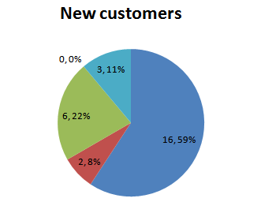
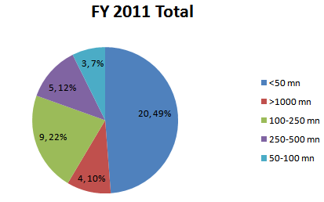
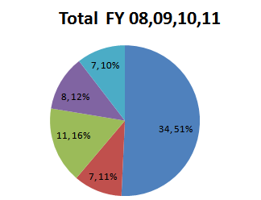
Customer Analysis across the size of Business
FY 2019 Total
FY 2019 Total
Total FY 15, 15, 17, 18
New customers are of FY 2019 Acquisitions

Slide 23
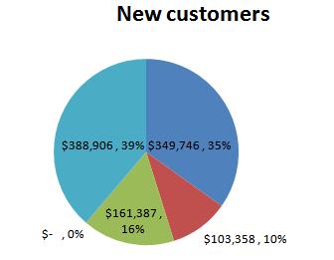
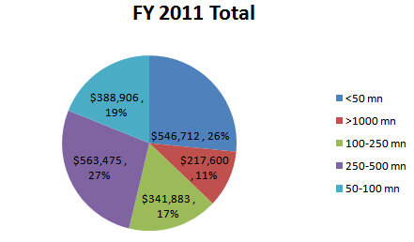
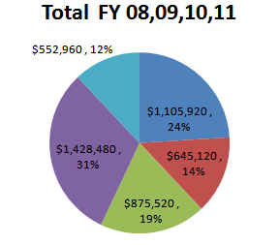
Sum of Revenue Realized across the customer’s size of Business
FY 2019 Total
Total FY 15, 15, 17, 18

Slide 24
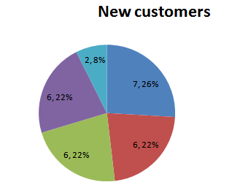
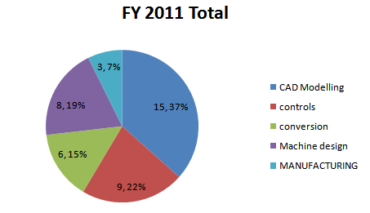
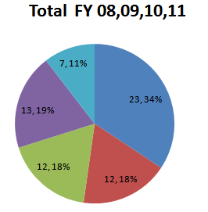
No of customers across the type of projects executed
FY 2019 Total
Total FY 15, 15, 17, 18

Slide 25
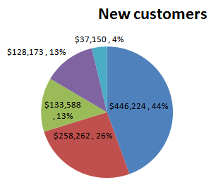
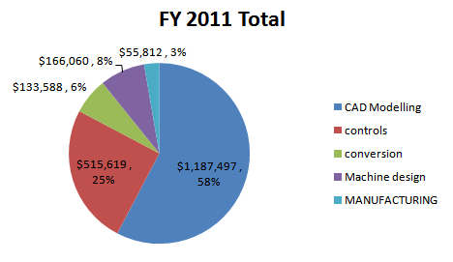
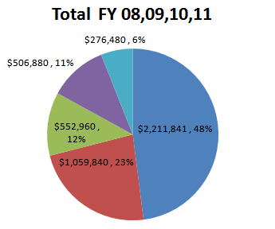
Sum of Revenue realization across the type of projects executed
FY 2019 Total
Total FY 15, 15, 17, 18

Slide 26
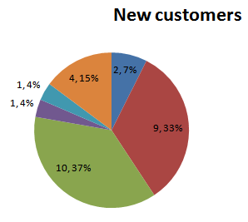
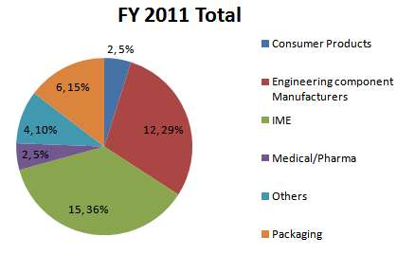
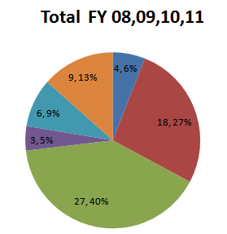
No of customers across the type of industry
FY 2019 Total
Total FY 15, 15, 17, 18

Slide 27
Top Contributions to External Revenue.
Acoount Nmae | Type of Customer | CFO | Revenue Realised | % Contribution to total External revenue | Cumulative %
Customer ABC | New | Sales Executive 1 | $359,889 | 16% | 16%
Customer DEF | Existing | Sales Executive 2 | $357,254 | 16% | 31%
Customer GHI | New | Sales Executive 3 | $164,143 | 7% | 39%
Customer JKL | Existing | Sales Executive 1 | $129,785 | 6% | 44%
Customer MNO | Existing | Sales Executive 2 | $110,602 | 5% | 49%
Customer PQR | Existing | Sales Executive 1 | $97,785 | 4% | 53%
Customer STU | Existing | Sales Executive 2 | $89,242 | 4% | 57%
Customer VXY | Existing | Sales Executive 3 | $87,299 | 4% | 61%
12 out of 53 External Customers contributed to 75 % of Revenue
The remaining 41 customers contributed 25% or about $0.5mn

Slide 28
Sales & Marketing Metrics
 | No. of Qualified leads | No. of Proposals | No. of Orders | Leads to Proposals | Proposals to Order | Average Deal size or PO (USD) | Average Revenue from New customer (USD)
Hoshin Target | 360 | 90 | 30 | 4:1 | 3:1 | $20,000 | NA
Actual (Aug’- Mar) | 191 | 35 | 17 | 6:1 | 2:1 | $17,575 | $31,156
Actual (Aug-Apr) | 218 | 37 | 19 | 7:1 | 2:1 | $17,295 | $32,335
Actual (Aug-May) | 233 | 39 | 22 | 6:1 | 2.5:1 | $17,295 | $32,335
Actual (Aug-June) | 247 | 41 | 24 | 6:1 | 2:1 | $16,488 | $30,623
Actual (Aug-July) | 254 | 44 | 25 | 6:1 | 2:1 | $16,172 | $30,478
All measures are considered from Aug -10
Only new customer acquisition After Aug 2010 are considered
Only External companies from USA and EU are considered
Please refer to Attached excel to view Data regarding New PO’s.

Slide 29
Average proposal Time
(Hoshin Target:5 Days)
Please refer to attached Excel to view the corresponding Data
Proposals submitted to External New customers after August are considered.

Slide 30
YIELD
MONTH | USA ONSITE | USA OFFSHORE | EU ONSITE | EU OFFSHORE | AVG YIELD
OCT | 40.69 | 29.27 | 57.69 | 18.06 | 21.72
NOV | 34.57 | 29.07 | 32.31 | 19.81 | 23.05
DEC | 53.88 | 27.86 | 55.17 | 19.04 | 21.38
JAN | 67.86 | 27.26 | NA | 23.97 | 26.63
FEB | 65.00 | 28.46 | NA | 22.99 | 24.16
MAR | 73.72 | 29.19 | 38.48 | 20.38 | 25.95
APR | 62.10 | 27.91 | 63.51 | 22.84 | 28.09
MAY | 54.36 | 26.75 | 34.61 | 17.65 | 22.82
JUN | 53.95 | 33.7 | NA | 19.48 | 26.76
JULY | 45.09 | 22.15 | 60 | 22.66 | 24.37
Note:
For Customer ABC and Customer XYZ both onsite and offshore billing are same, corresponding revenues are included in offshore figures.
For onsite (Both USA and Europe), Expenses are included in revenues.

Slide 31
CUSTOMER FEEDBACK REPORT
MONTH | CUSTOMER NAME | CFR
APRIL | Customer ABC | 4.2
 | Customer DEF | 4.5
 | Customer GHI | 4.35
MAY | Customer JKL | 4
 | Customer MNO | 4.6
 | Customer PQR | 4.2
 | Customer STU | 4.26
JUNE | Customer VXY | 4.8
 | Customer ABC | 4
 | Customer DEF | 4.6
 | Customer GHI | 4.47
JULY | Customer JKL | 4.4

Slide 32
CUSTOMER RETENTION

Slide 33
Lost customers
FY10-11 | Active Customers | Lost Customers | Name of Customer Lost | Customer Attrition Rate
Q1 2018 | 27 | 1 | Customer ABC | 4%
Q2 2018 | 27 | 1 | Customer DEF | 4%
Q3 2018 | 34 | 0 | Customer GHI | 0%
Q4 2018 | 32 | 2 | Customer JKL | 6%
Q1 2019 | 39 | 3 | Customer MNO | 3%
Q2 2019 | 43 | 1 | Customer PQR | 3%
Q3 2019 | 41 | 1 | Customer STU | 2%

Slide 34
Yield (Revenue & Cost / Employee)

Slide 35
Demand Generation program –
USA Metrics
IS | Inside sales
EA | External Agencies

Slide 36
Demand Generation Metrics (US)
No of Leads Generated=0
Account Name | Owner | Lead Source
No of RFP received=11
Account Name | Owner | Project/Opportunity Description | Lead Source
Customer ABC | Sales Executive 1 | Machine Design for Sheath Threading | Inside Sales
Customer DEF | Sales Executive 2 | Sunhil onsite Controls visit | Marketing
Customer GHI | Sales Executive 3 | Naga 3 month onsite mechanical vist | Referral
Customer JKL | Sales Executive 1 | Parts Procurement - Tab 1 | Inside Sales
Customer MNO | Sales Executive 2 | Parts Sourcing - (70) ea of cast part 1990384 without maching | Marketing
Customer PQR | Sales Executive 3 | Procurement (200 ea) Electrical Component TS68000CR16 | Referral
Customer STU | Sales Executive 1 | SolidWorks Training | Inside Sales
Customer VXY | Sales Executive 2 | Detailing of 31 parts | Marketing
Customer ABC | Sales Executive 3 | Contorl Panel for Alfay Site | Referral
Customer DEF | Sales Executive 2 | Converting PLC code for UV MicroDynamics | Marketing
Customer GHI | Sales Executive 3 | SolidWorks Training | Referral

Slide 37
Demand Generation Metrics (US)
No of proposals submitted=11
Account Name | Owner | Project/Opportunity Description | Lead Source
Customer ABC | Sales Executive 1 | Graphic visualization of wellbore at Robbins and Myers. | Inside Sales
Customer DEF | Sales Executive 2 | Machine Design for Sheath Threading | Marketing
Customer GHI | Sales Executive 3 | STS-CP-263 | Referral
Customer JKL | Sales Executive 1 | Sunhil onsite Controls visit | Inside Sales
Customer MNO | Sales Executive 2 | Naga 3 month onsite mechanical vist | Marketing
Customer PQR | Sales Executive 3 | Additional Onsite support for Gleason | Referral
Customer STU | Sales Executive 1 | Parts Sourcing - (70) ea of cast part 1990384 without maching | Inside Sales
Customer VXY | Sales Executive 2 | SolidWorks Training | Marketing
Customer ABC | Sales Executive 3 | Detailing of 31 parts | Referral
Customer DEF | Sales Executive 2 | Contorl Panel for Alfay Site | Marketing
Customer GHI | Sales Executive 3 | Converting PLC code for UV MicroDynamics | Referral
No of orders closed = 5
Account Name | Owner | Project/Opportunity Description | Deal Value | Lead Source
Customer GHI | Sales Executive 1 | Engineering Service | $ 57,000.00 | Inside Sales
Customer JKL | Sales Executive 2 | Mfg support and value engg of UV disinfectant | $ 50,000.00 | Marketing
Customer MNO | Sales Executive 3 | Balpure documentation support (Onsite and Offshore) | $ 53,600.00 | Referral
Customer PQR | Sales Executive 1 | Sunhil onsite Controls visit | $ 31,200.00 | Inside Sales
Customer STU | Sales Executive 2 | Naga 3 month onsite mechanical vist | $ 31,200.00 | Marketing

Slide 38
Proposal Generation Program
Average proposal Time (In no of Days)
Type Of proposal | Target(No of days) | October | November | December | January | February
CAD | 5 | NA | 4.7 | 7 | 1 | 3.8
RPA | 12 | 8.5 | 1 | NA | 12.25 | 9.2
ERP | 12 | 45 | 57 | NA | 30.33 | 14.6

Slide 39
Customer Satisfaction Program
MONTH | CUSTOMER NAME | CFR
Sep-19 | Customer ABC | 2.80
 | Customer DEF | 4.60
 | Customer GHI | 3.50
 | Customer JKL | 4.60
 | AVERAGE | 3.88
Oct-19 | MIL-TEK | 4.85
 | PBM GRAPHICS. INC | 4.80
 | AVERAGE | 4.83
Nov-19 | WARD SUSTAINING ENGINEERING | 4.20
 | WARD AFTER MARKETING | 4.90
 | AVERAGE | 4.55
Dec-19 | SEVERN TRENT | 4.40
 | AVERAGE | 4.40
Jan-20 | DTMT | 3.00
 | McNICHOLS | 5.00
 | RENOLD | 4.40
 | GLEASON | 3.75
 | FAGOR ARRASATE | 3.40
 | AVERAGE | 3.91
Feb-20 | HSA - UK | 4.50
 | DTMT ( CONTROLS) | 4.25
 | NOVATECH INC | 4.00
 | MCR SYSTEMS | 3.70
 | AVERAGE | 4.11

Slide 40
Customer Retention Program-Targets
Customer Name | Base Line Plan | Target Revenue (USD) | Extra Revenue to be generated before Sep, 2012 (USD)
Customer ABC | $301,140 | $351,140 | $50,000
Customer DEF | $156,000 | $200,000 | $44,000
Customer GHI | $0 | $150,000 | $150,000
Customer JKL | $150,000 | $305,000 | $155,000
Customer MNO | $80,000 | $100,000 | $20,000
Customer PQR | $90,000 | $200,000 | $110,000
Customer STU | $57,000 | $200,000 | $143,000
Customer VXY | $120,000 | $200,000 | $80,000
Customer ABC | $96,000 | $200,000 | $104,000
Customer DEF | $924,000 | $924,000 | $0
Customer Total | $1,974,140 | $2,830,140 | $856,000

Slide 41
Customer Retention Program-Status
Customer Name | Baseline Revenue(USD) |  | Diff (USD) | Additional Revenue (USD) |  | Diff (USD) | Total Diff (USD)
 | Planned (A) | Actuals (B) |  | Planned (C) | Actuals ( D)
Customer ABC | $125,475 | $133,744 | $8,269 | $11,111 | $0 | ($11,111) | ($2,842)
Customer DEF | $54,000 | $65,284 | $11,284 | $18,333 | $0 | ($18,333) | ($7,049)
Customer GHI | $0 | $0 | $0 | $62,500 | $9,619 | ($52,881) | ($52,881)
Customer JKL | $56,667 | $227,618 | $170,951 | $64,583 | $69,878 | $5,295 | $176,246
Customer MNO | $33,333 | $21,615 | ($11,718) | $8,333 | $0 | ($8,333) | ($20,052)
Customer PQR | $23,333 | $47,264 | $23,931 | $45,833 | $0 | ($45,833) | ($21,903)
Customer STU | $17,000 | $49,500 | $32,500 | $59,583 | $0 | ($59,583) | ($27,083)
Customer VXY | $50,000 | $52,000 | $2,000 | $33,333 | $119,819 | $86,486 | $88,486
Customer ABC | $40,000 | $38,400 | ($1,600) | $43,333 | $0 | ($43,333) | ($44,933)
Customer DEF | $375,000 | $365,335 | ($9,665) | $0 | $2,000 | $2,000 | ($7,665)
Total | $774,808 | $1,000,760 | $225,952 | $346,944 | $201,316 | ($145,628) | $80,323

Slide 42
Revenue Per Employee

Slide 43
Leads Generated for past three years
No of Executives : 2018 – 4 2019 – 8 2020 - 6

Slide 44
Leads Generated & Average leads for past three years

Slide 45
No.of Proposals sent to customers for past three years

Slide 46
Proposals Vs. Leads as a %

Slide 47
OI Impact Analysis

Slide 48
FY Revenue Dashboard

Slide 49
Historic ABC Performance

Slide 50
USA - Revenue (By Sales Executive)

